Slide 1






N.B.K.R. INSTITUTE OF SCIENCE AND TECHNOLOGY
VIDYANAGAR, TIRUPATI Dt, ANDHRA PRADESH.
Calculator with History
Basic operations.

Slide 2


Presentation by
TEAM NUMBER:15
BRANCH: COMPUTER SCIENCE ENGINEERING
SECTION: ASHOK SELVAN SIR
TEAM MEMBERS
SHAIK IMRAN[24KB1A05HQ]
SHAIK LATHEEF[24KB1A05HT]
MASTHAN BASHA[24KB1A05HU]
SHAIK CHAANDU[24KB1A05HF]
To;
FACULTY: SAI CHARAN SIR
BYTEXL MENTOR: ASHOK SELVAN SIR

Slide 3
INTRODUCTION
A basic calculator program written in C.
Supports addition, subtraction, multiplication, and division.
Saves each calculation into 'history.txt'.
Allows multiple calculations in one run.

Slide 4
Key Features of the Program
Takes two numbers and an operator from the user.
Performs selected operation using switch statement.
Handles division by zero error.
Saves results into 'history.txt'.
Supports multiple calculations (do-while loop).

Slide 5



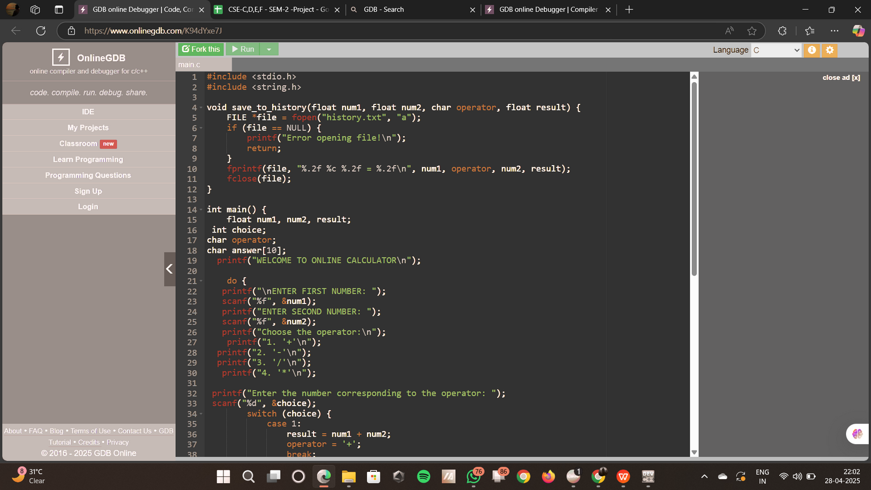

PIC OF SOURCE CODE

Slide 6
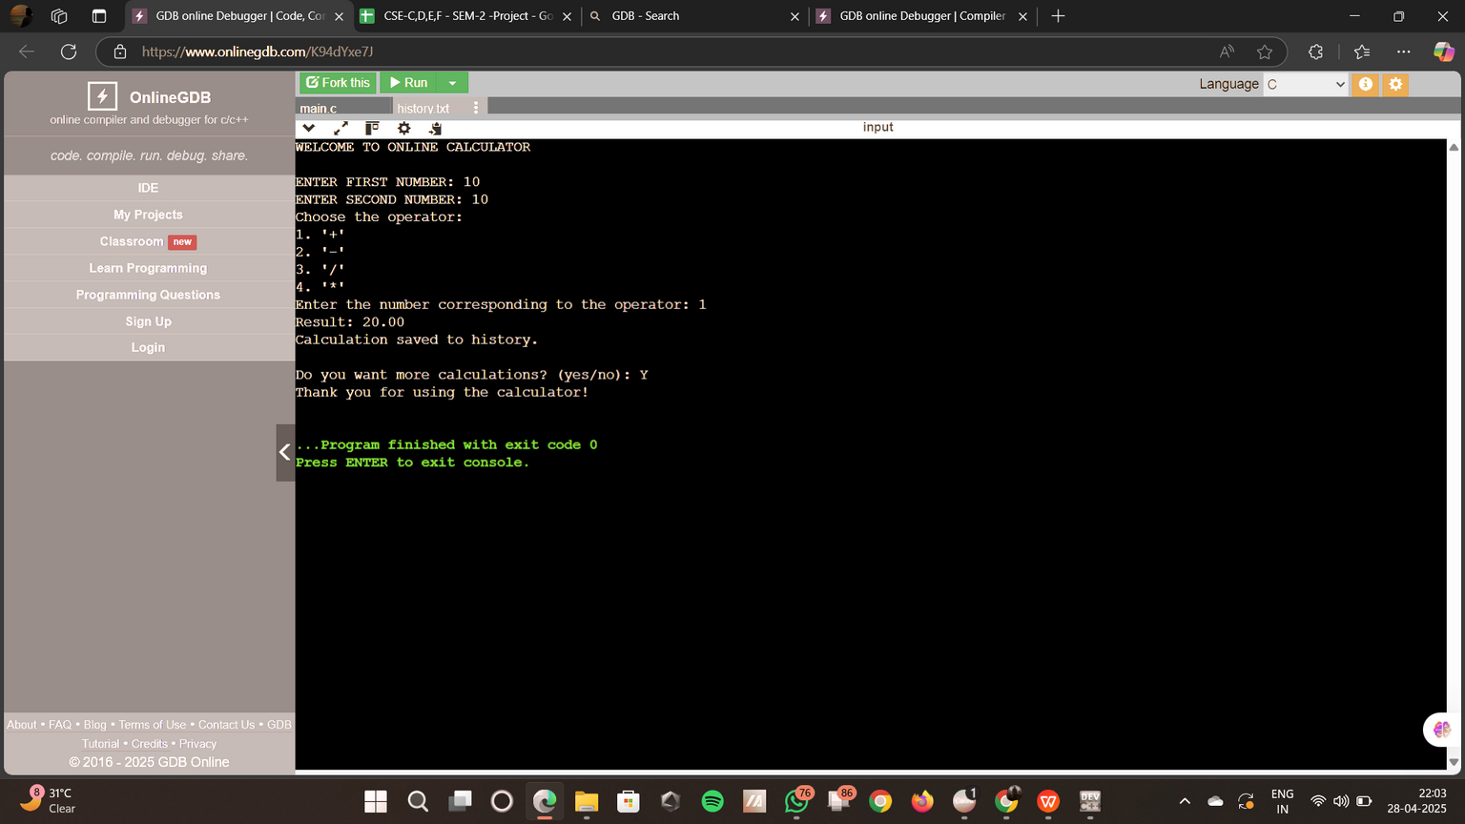
PIC OF OUTPUT

Slide 7


CODE LINK;
https://www.onlinegdb.com/K94dYxe7J

Slide 8

THANK YOU!
PRESENTED BY TEAM 15

